Slide 1

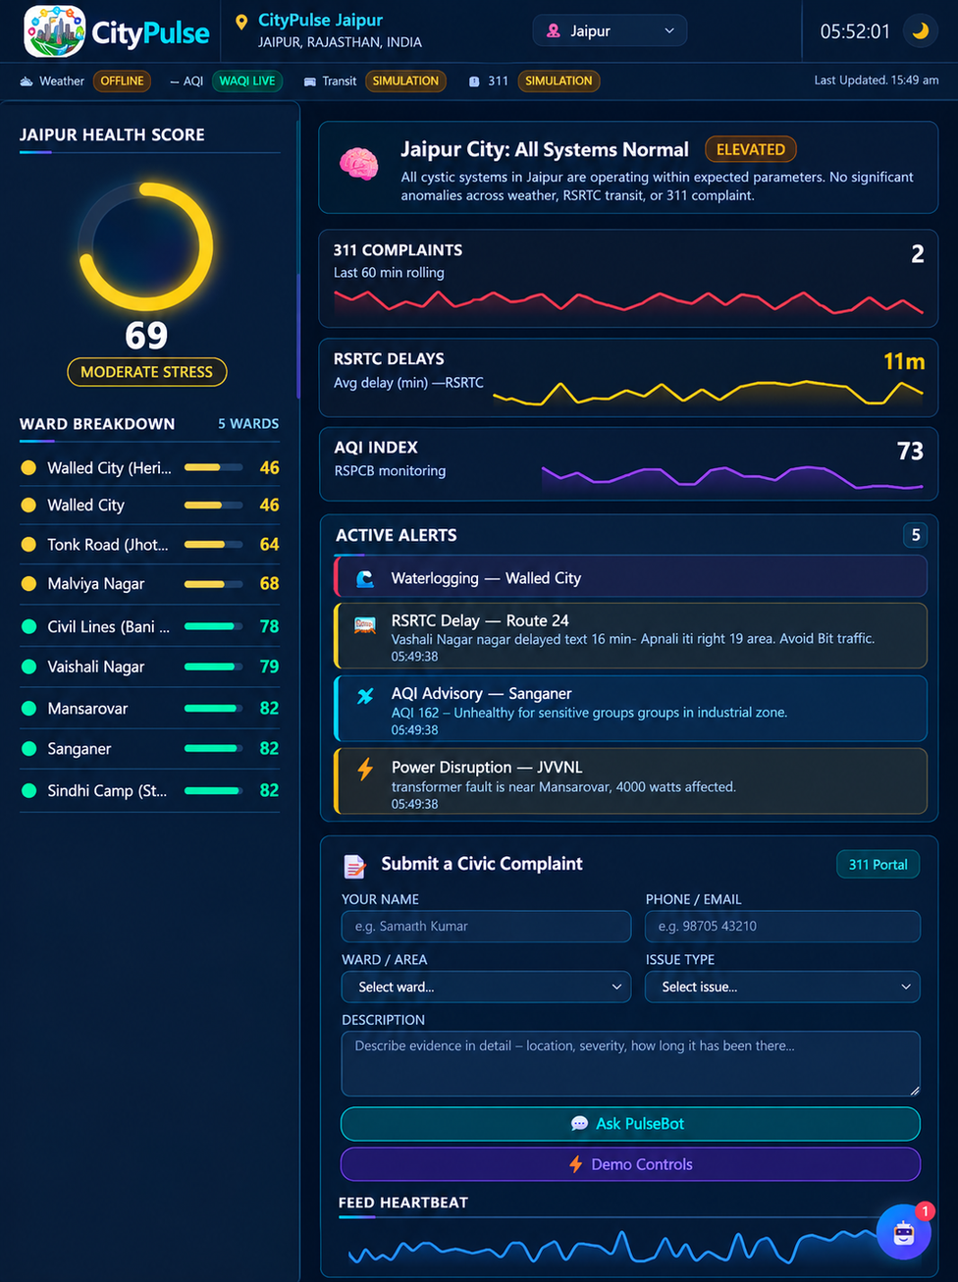

CityPulse
The Live Civic Health Dashboard
Real-time insights for a healthier, more connected city — combining weather, transit, air quality, and civic complaints into one unified view.
SMART CITY
CIVIC TECHNOLOGY
REAL-TIME DATA INTEGRATION
Team: Coding Knights · Amity University Rajasthan

Slide 2
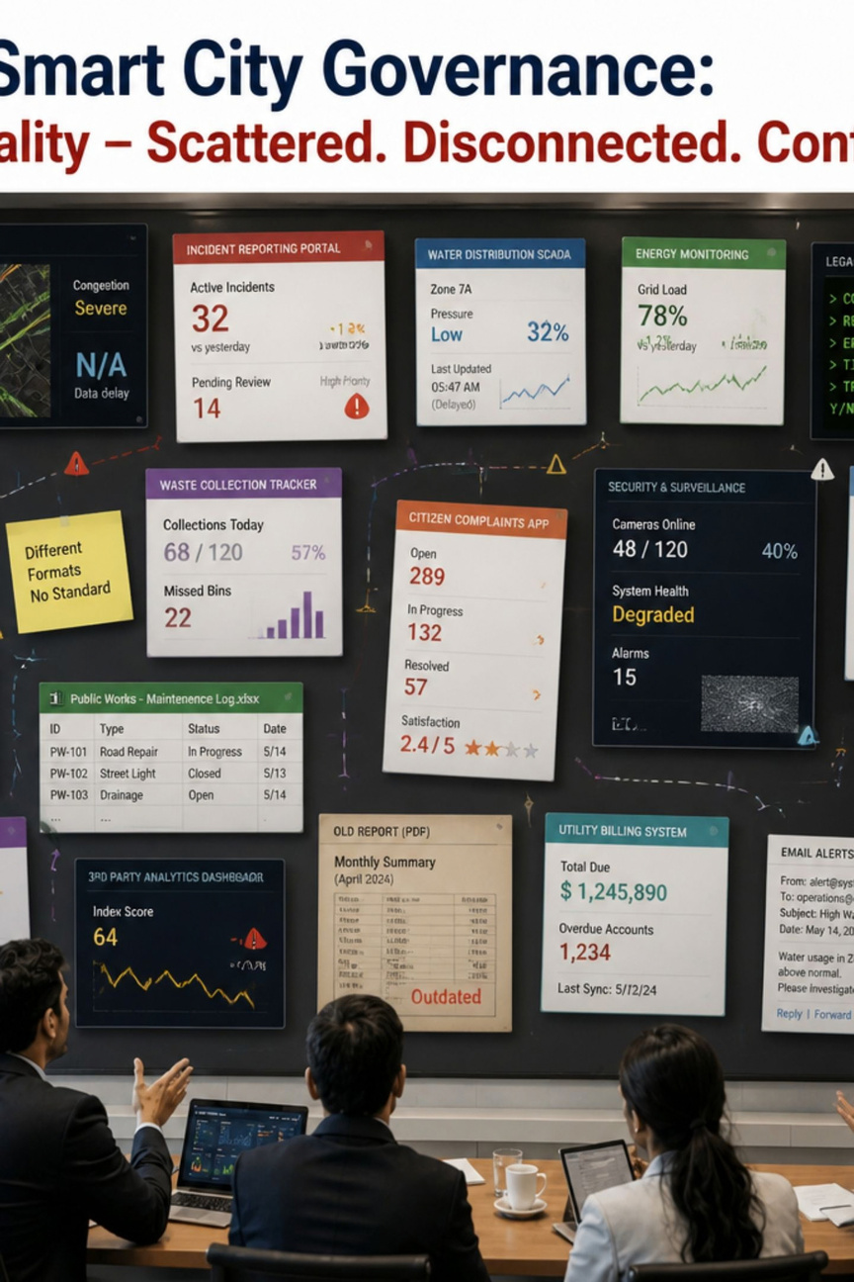

The Problem: City Information is Scattered
Cities generate data from many sources — weather, traffic, transit, air quality, power, and civic complaints — but these feeds are siloed, differently formatted, and updated at different times.
👤 Residents
Discover problems only after arriving. No clear picture of overall city conditions.
🏛️ City Officials
Must check multiple systems. Cross-source patterns stay hidden until manually escalated.
Core challenge: How do we turn scattered civic feeds into one clear picture of city health?

Slide 3
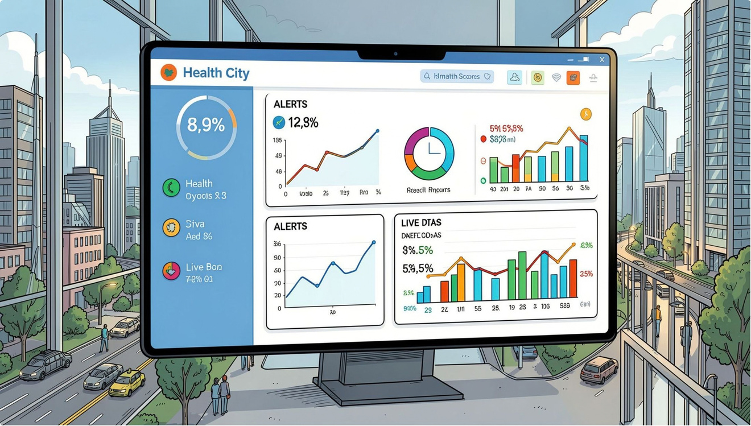
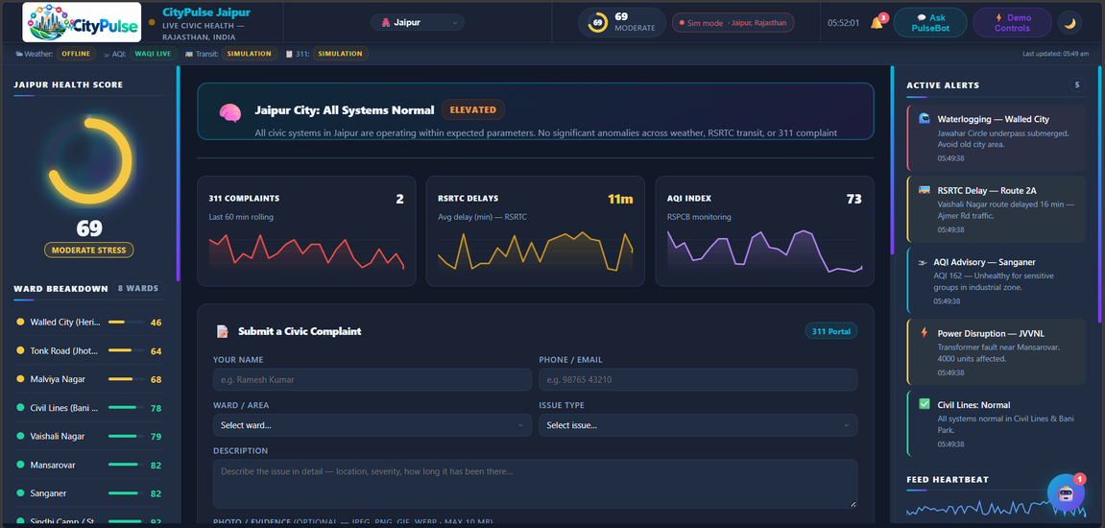
Introducing CityPulse
One Dashboard. Multiple Signals. One City Pulse.
CityPulse combines critical civic signals into a single live dashboard — replacing fragmented systems with a unified view of city health.
City Health Score
Ward-Level Insights
Overall civic-health indicator
Neighborhood breakdowns across the city
Live Feeds + Alerts
Correlations & Anomalies
Weather, transit, AQI, 311 complaints
Cross-source pattern detection

Slide 4

Impact & Future Scope
CityPulse transforms urban data into actionable intelligence, empowering both citizens and leaders to build a more responsive and resilient city.
Residents
Make informed daily decisions and actively engage with civic health, improving quality of life.
Officials
Optimize resource allocation and respond proactively to urban challenges with data-driven precision.
Our roadmap includes expanding data sources, predictive analytics, and AI-powered recommendations for urban planning.

Slide 5
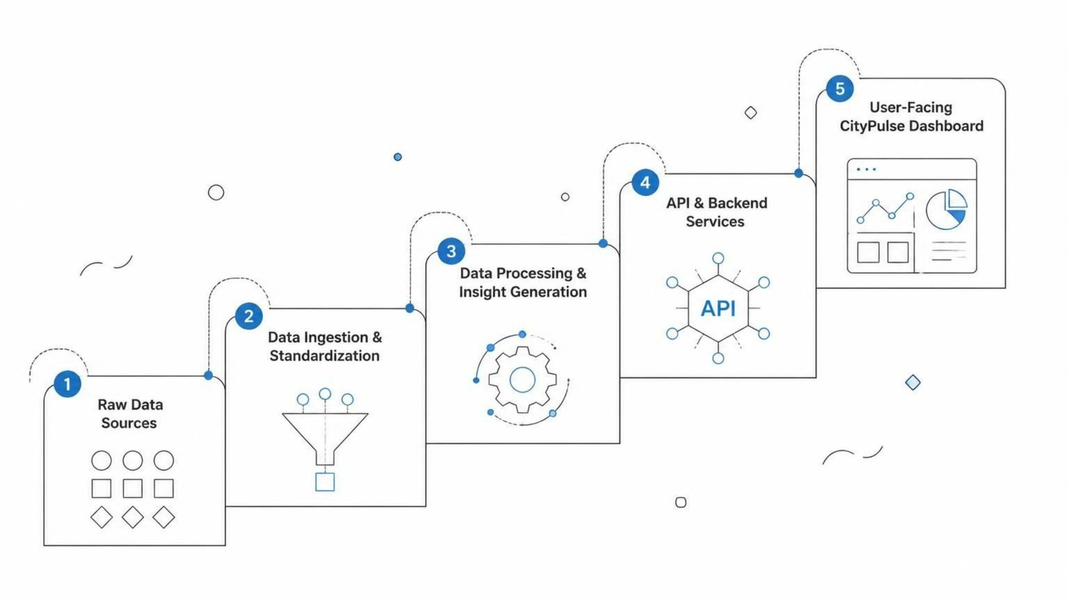
Technical Architecture
CityPulse is built on a robust, layered architecture designed for scalability, real-time data processing, and seamless integration of diverse civic data sources.
This pipeline ensures that raw, fragmented data is transformed into actionable intelligence, presented intuitively to city officials and residents.

Slide 6
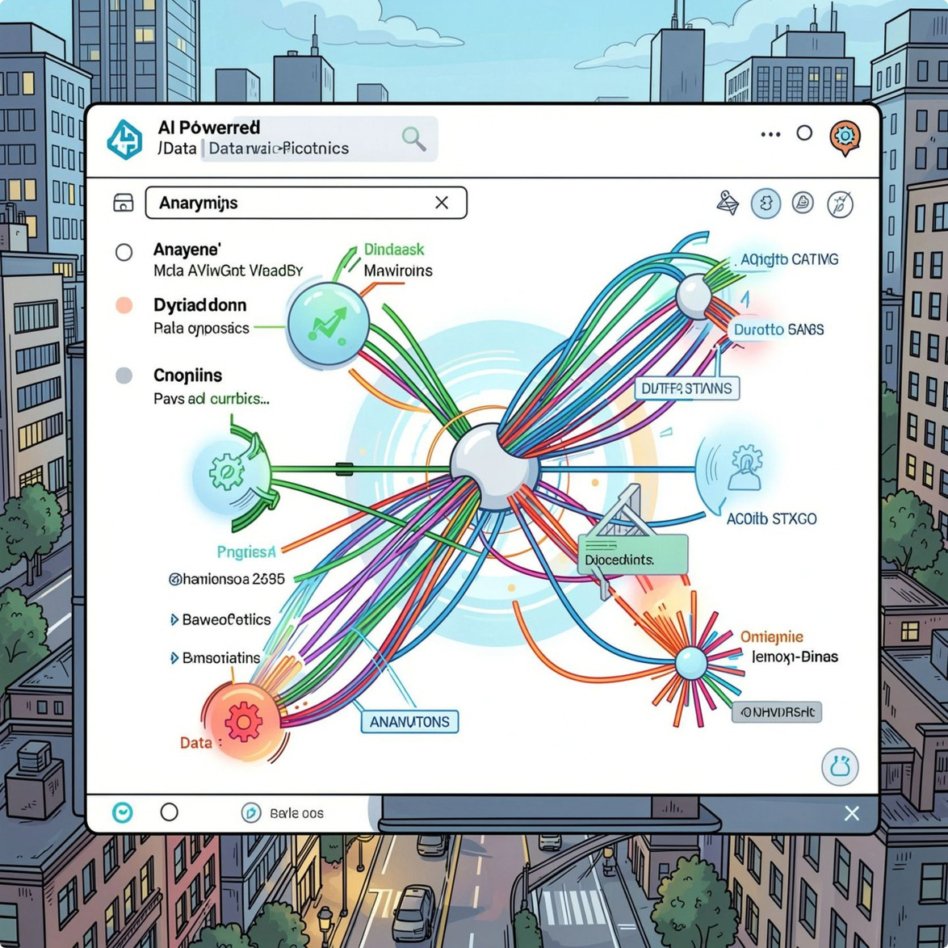
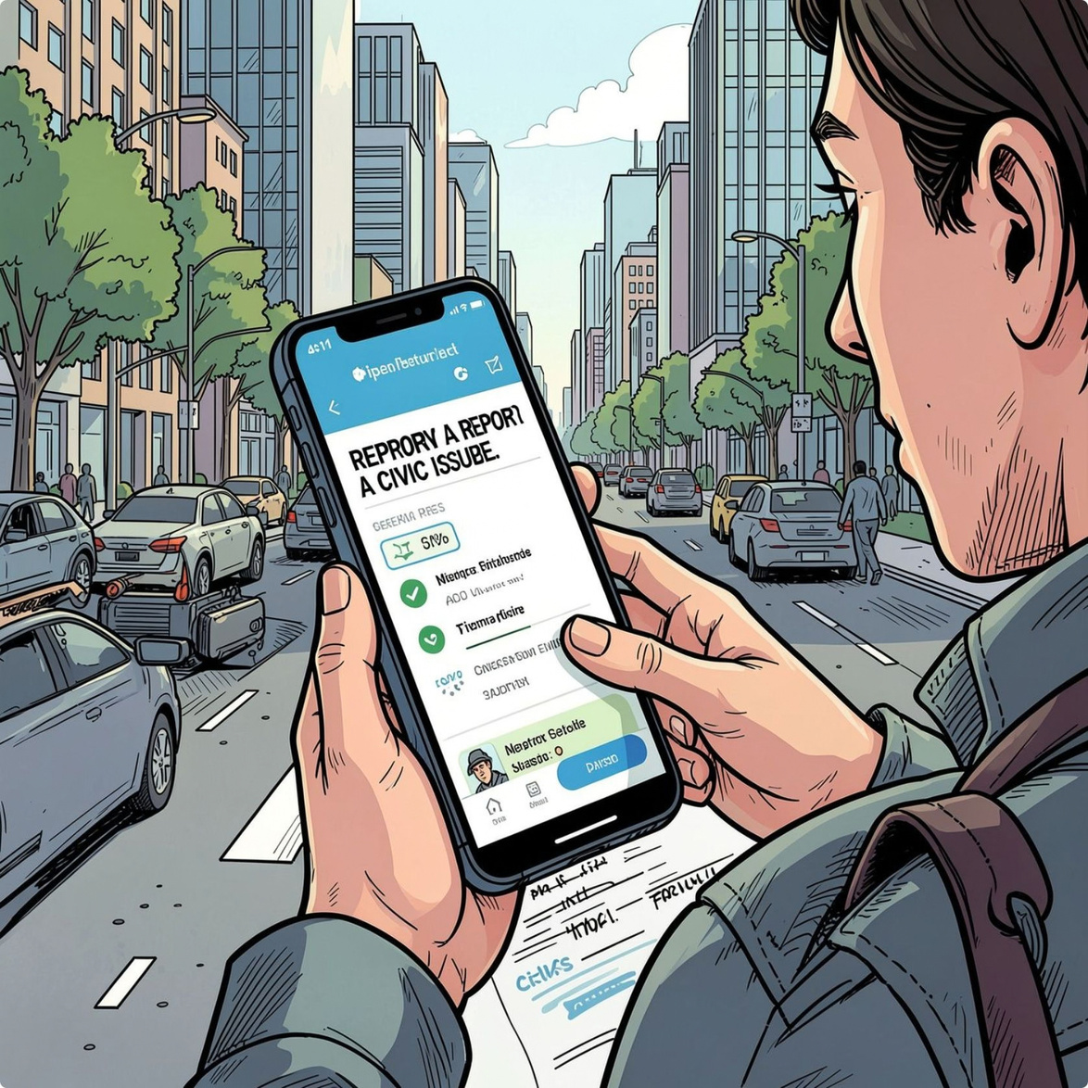
Intelligent Detection & Citizen Reporting
CityPulse actively uncovers patterns from integrated data and empowers residents to become active participants in maintaining a healthier city.
Smart Correlation & Anomaly Detection
Seamless Citizen Complaint Submission
Our platform continuously cross-references disparate data—from weather to 311 reports—to identify critical correlations and unusual events that might otherwise go unnoticed.
Residents can effortlessly report issues directly through a user-friendly mobile interface. These submissions are instantly integrated into the CityPulse dashboard, ensuring real-time civic awareness.
  Proactive problem identification
  Predictive insights for city planning
  Intuitive reporting process
  Direct feedback loop to city officials

Slide 7


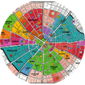
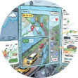
CityPulse: Key Features
Empowering Decisions with Comprehensive Insights
CityPulse provides a holistic view of urban dynamics, transforming raw data into actionable intelligence for residents and officials.
City Health Score
Ward-Level Breakdown
Live Feeds & Alerts
A dynamic, real-time indicator that aggregates data from all sources to provide an instant overview of civic well-being.
Analyze specific neighborhood conditions with granular data, enabling localized responses and resource optimization.
Access continuous updates on weather, transit, air quality, and 311 requests, with instant notifications for critical events.

Slide 8
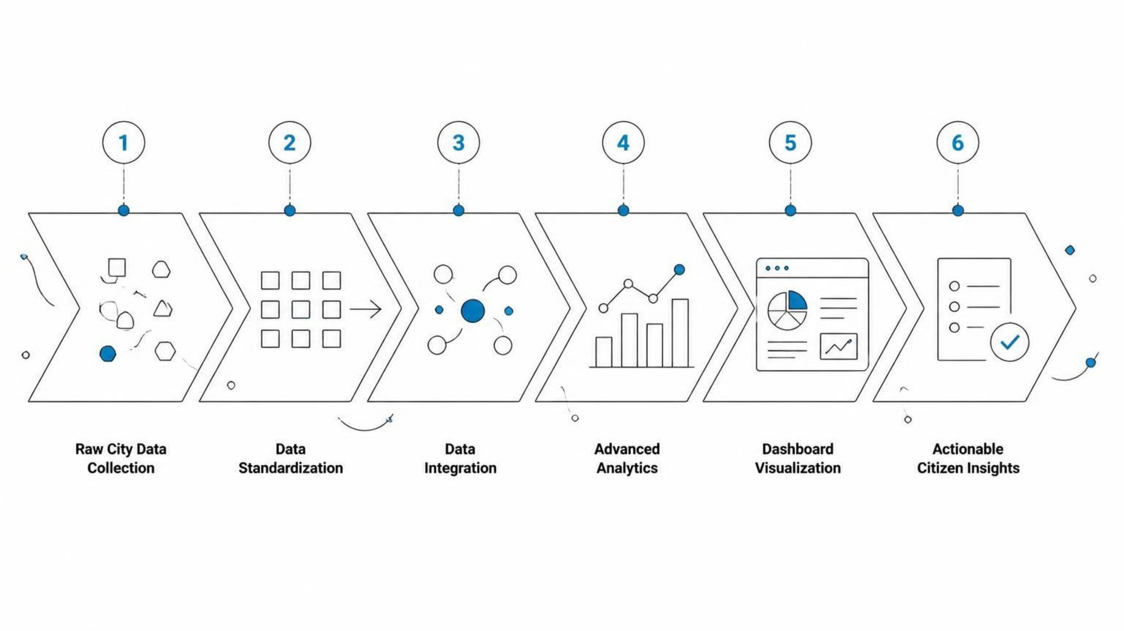
How CityPulse Works
CityPulse transforms disparate data sources into a cohesive, actionable vision for urban management.

Slide 9

Thank You

